Slide 1
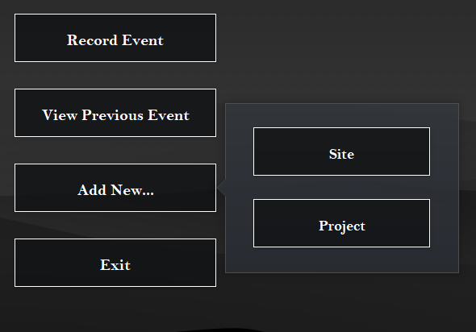
Macroinvertebrate Database App
Home Page
Primary feature; directs user to data entry pages to record samples
View and edit previous entries; useful for quality checking (QC).
Allows you to add new sites/projects. Likely won’t happen often.
Closes the application

Slide 2
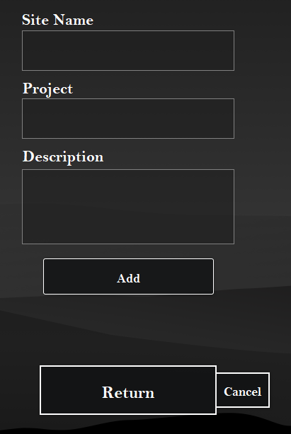
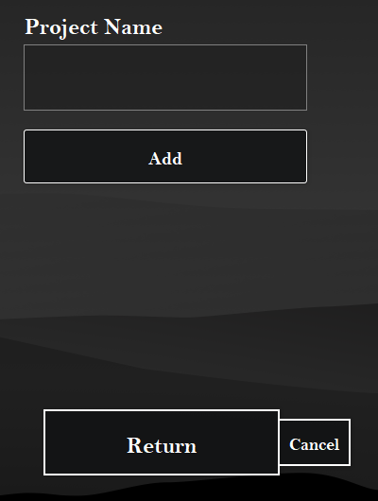
Add Site
or Project
Site
Project
Simple process; input site/project data, click add, and return.

Slide 3
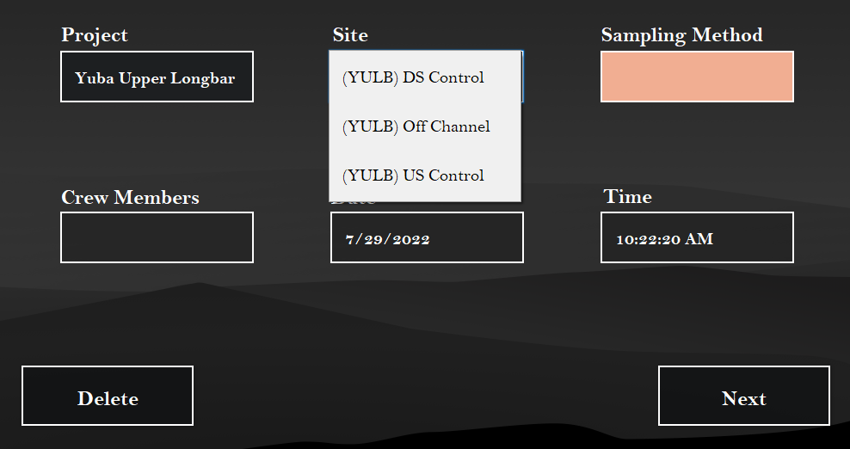
Record Event
Dropdown that filters based on project
Dropdown to select one of four sampling methods:
Drift, Hess, Rock, or Schindler
Date and Time autofill, but can be edited.
Navigates to field info page

Slide 4
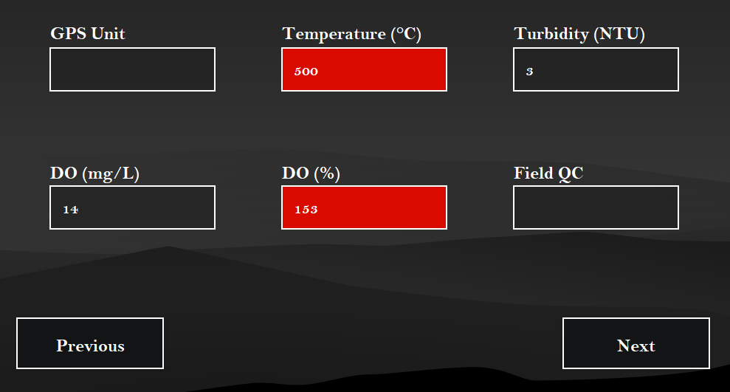
Field Info
Simple QC; highlights field red when unrealistic data is entered, but can be ignored
Navigates to sample info page

Slide 5
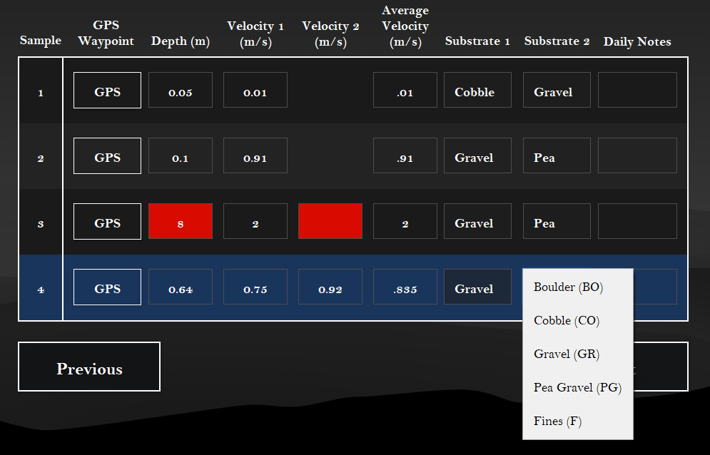
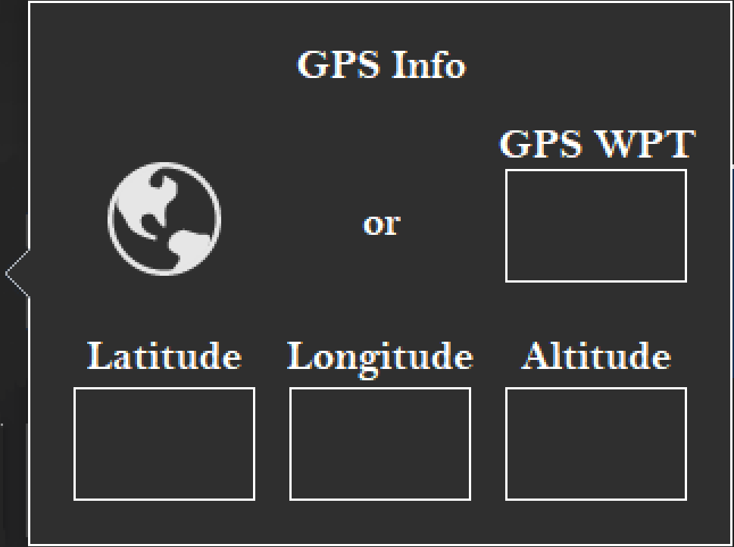
Sample Info
More QC; if depth >= 0.6, 2nd velocity field opens
Automatic Calculation
GPS Button pop-up field to enter waypoint or click Globe icon to use iPad GPS
Substrate Field is a dropdown
(Next button)
Navigates to sample-specific data page; different page appears depending on previously selected sampling method
Note: # of samples is either 4 or 8, depending on sampling method

Slide 6
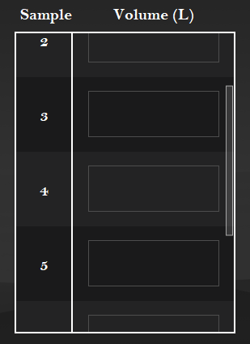
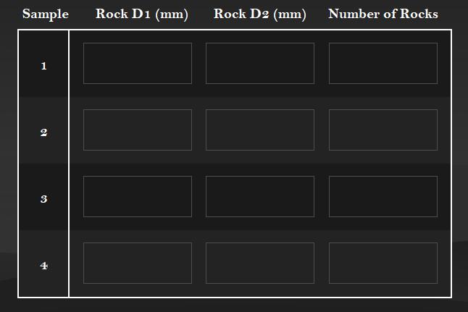
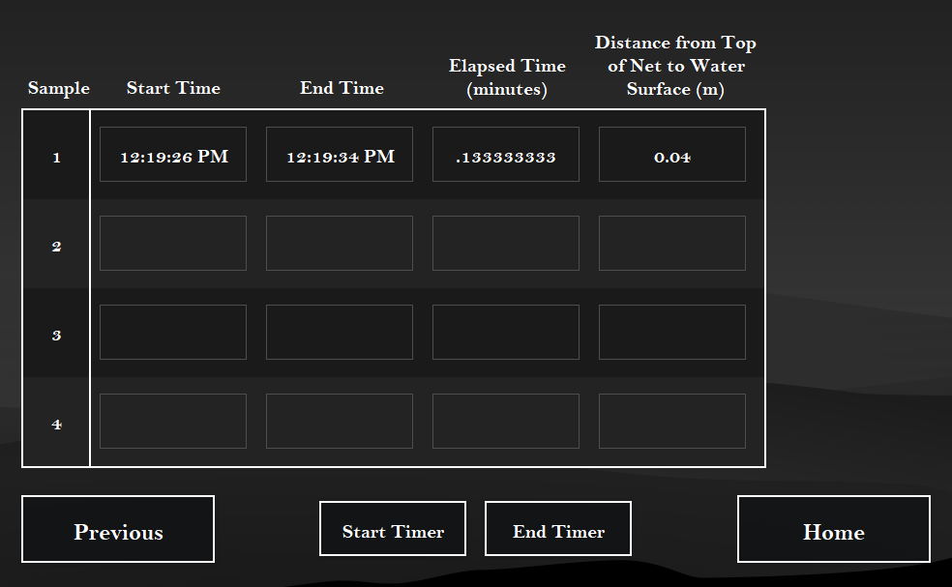
Sample-specific Data
Upon clicking next on the previous page, the user is directed to one of these pages depending on the chosen sample type. Hess samples do not have sample-specific data and will be directed to the home page.
Schindler
Rock
Drift

Slide 7
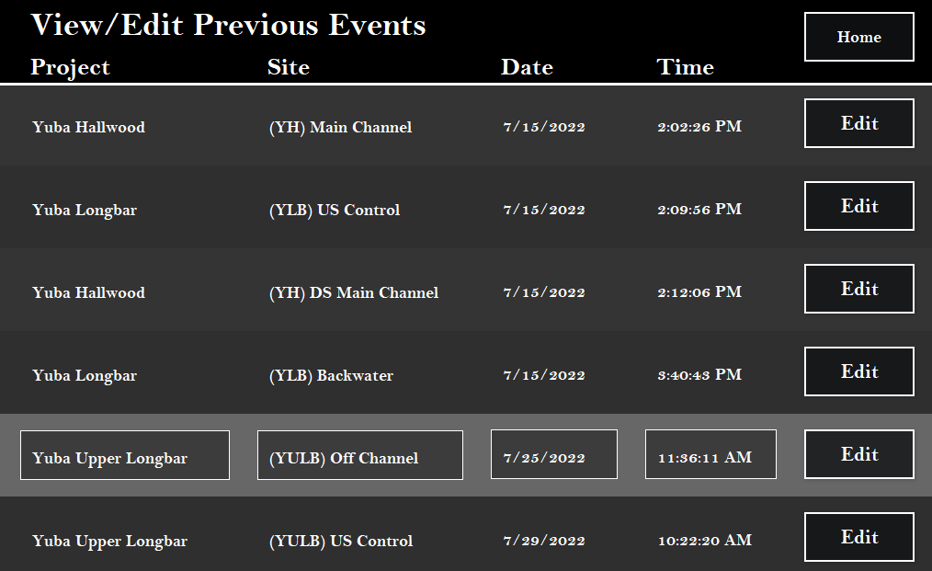
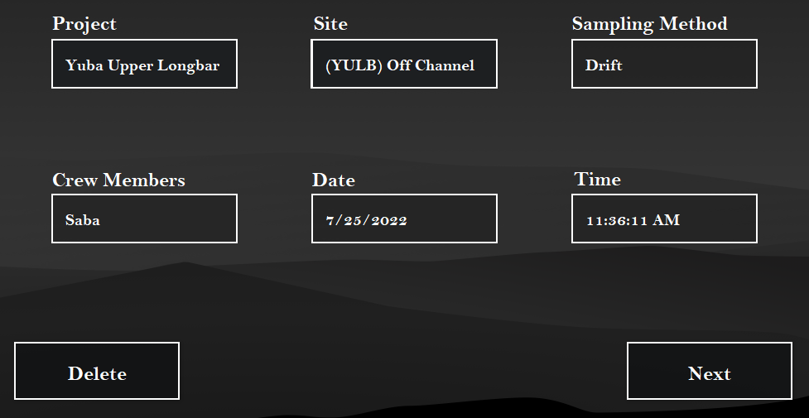
View and Edit Previous Events
Clicking edit will direct the user to the selected event and allow them to review, edit, or delete data from the event.
(second option on home page)

Slide 8
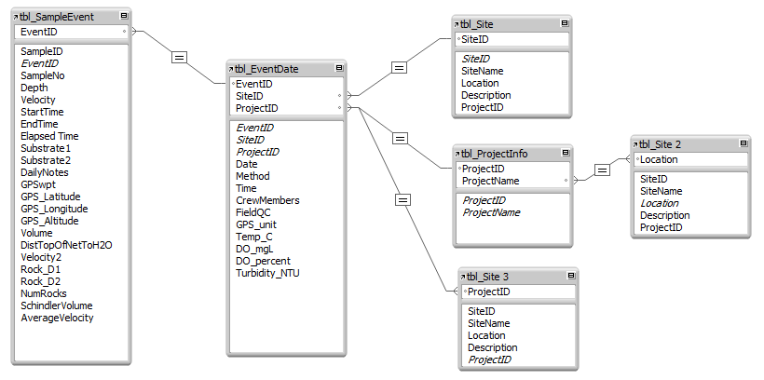
Backend Relational Database
The primary table
Uses IDs for sites and projects to access their names (and other info if needed).
This table holds all general data for all trips to the field
Sample data is stored in the sample table; all samples from a given event are linked to that event’s ID
All sample data
All general event data

